Slide 1
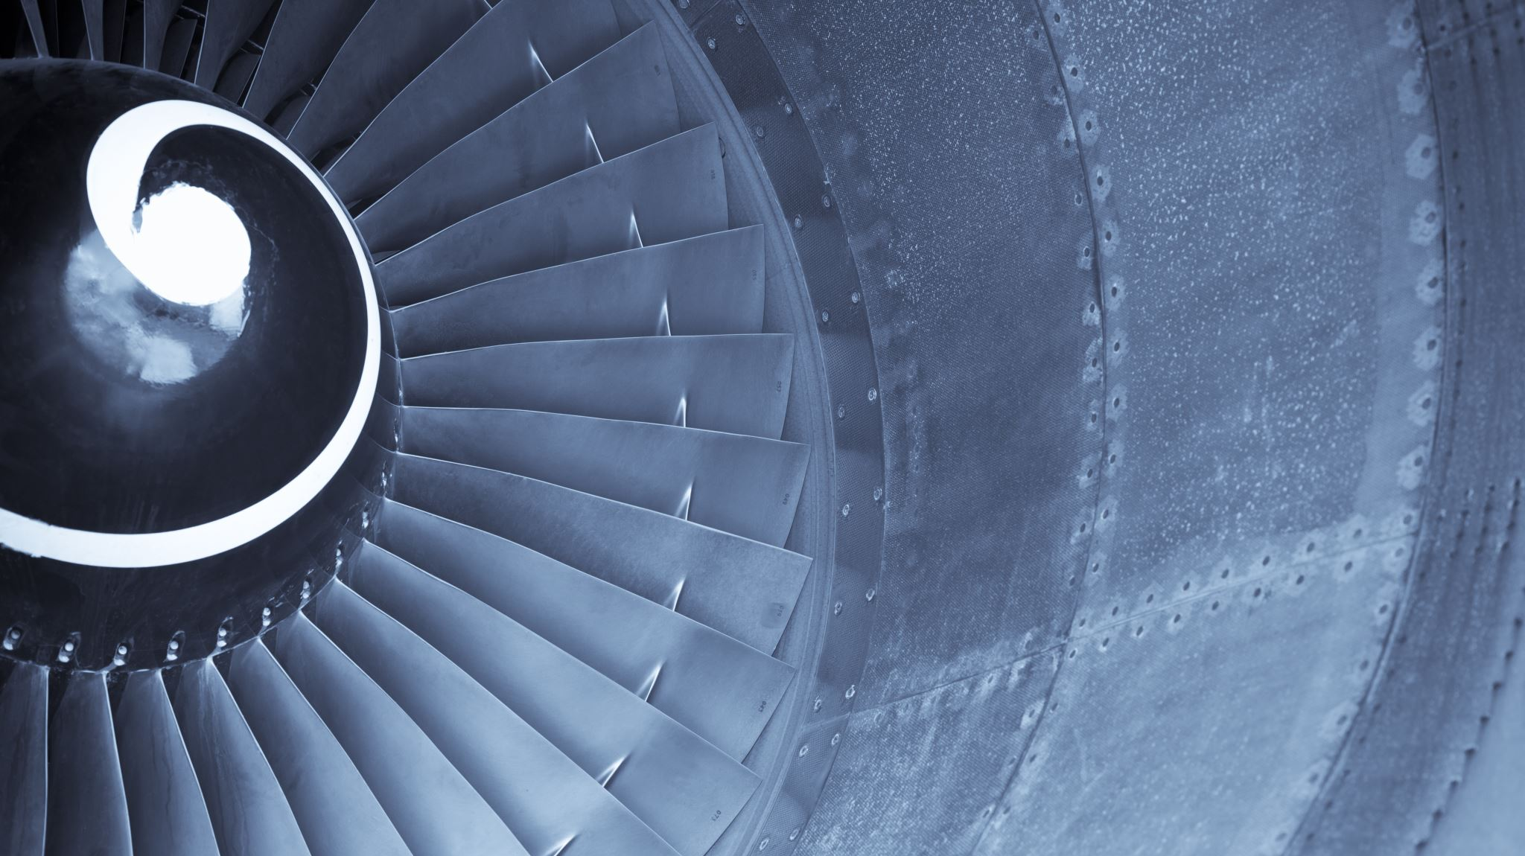

FYP Proposal Presentation
Project Supervisor
Engr. Muhammad Nauman
Group Members
M. Junaid Maqsood (01-132202-015)
M. Hassan Khan (01-132202-022)
Zain-ul-Abeedin (01-132202-035)

Slide 2
Predictive & Preventive Maintenance System

Slide 3

Contents
Background
Problem Statement
Objectives
Methodology
Timeline
Scope

Slide 4


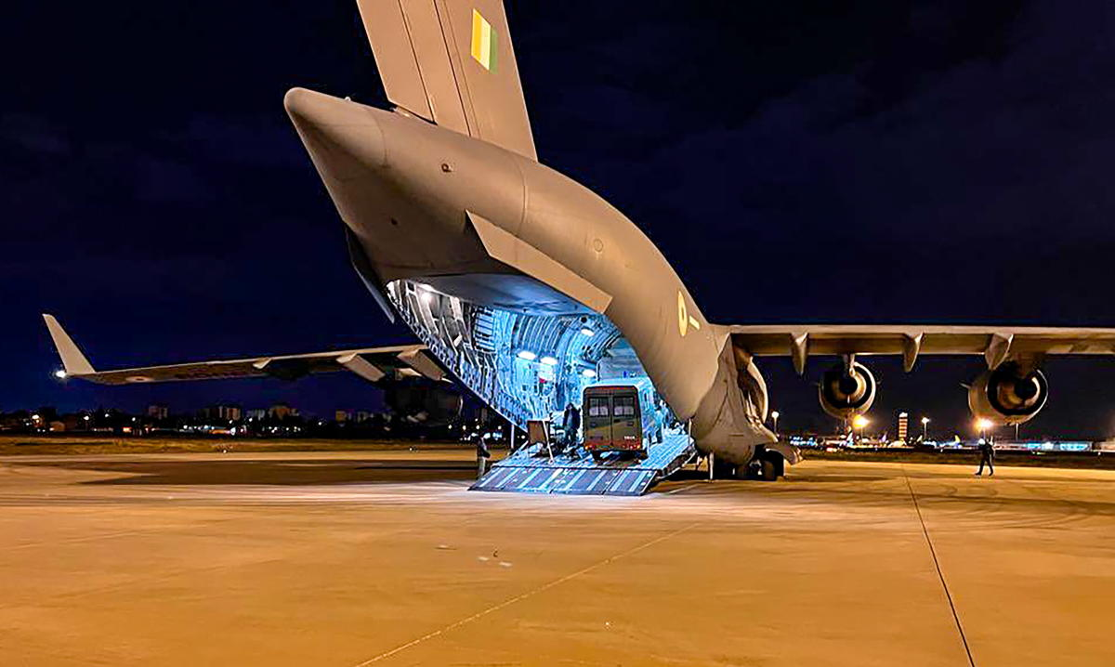
Background
The turbofan jet engines are an important part of aircrafts, and their reliable performance is crucial for air travel.
However, there can be unexpected failures or malfunctions in engines which can cause many problems such as
Increased maintenance costs.
Compromised passenger safety.
Flight cancellations.
Substantial financial losses for airlines.

Slide 5
Contd...
The Airline Maintenance Cost Executive Commentary Edition 2019 reported the annual maintenance, repair, and overhaul cost was 9% ($69 billion) of the total operational cost.
Traditional maintenance approaches, such as scheduled or reactive maintenance, often result in suboptimal resource allocation, increased downtime, and higher maintenance costs.
Pros
Simple
Familiarity
Cons
Reactive
Increased Risk
Inefficient
Lack of visibility

Slide 6

Contd...
Optimal Predictive Maintenance can be scheduled to reduce the maintenance cost and avoid equipment downtime.
The remaining useful life prediction algorithm in combination with RNN and LSTM long short-term memory .
The average accuracy ranges from 85-87%.

Slide 7

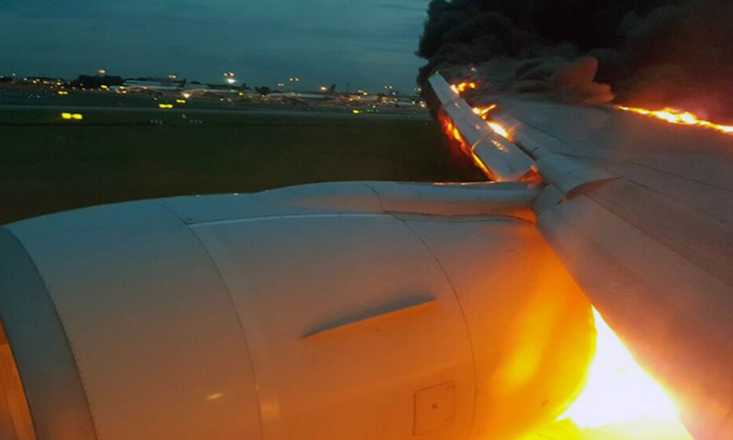
Problem Statement
To automate a system that calculates the remaining useful life of turbofan jet engines and alert the maintenance officers to provide maintenance to required aircraft before any failure or malfunctions occur.

Slide 8

Objectives
Predict the remaining useful life of turbofan engines.
Predict when an aircraft needs maintenance.
To achieve high accuracy.
Reduce maintenance costs.
Improve passenger safety.

Slide 9

Methodology
Acquiring Dataset
Feature Extraction
Model Training
Estimating Remaining Useful Life
Data Pre-processing
Feature Selection
Data Normalization
Importing the dataset.
Build an Architecture
Initialize Parameters
Train
Finish one Epochs
Maximum Epochs
Input Test Dataset
Remaining Useful Life Estimations.
Result Evaluation
Dashboard
Create a dashboard.
Add or remove device.
Easy to monitor condition of device.

Slide 10

Scope
Aviation
Complex machines
Neglecting maintenance can lead to:
Mechanical failures
Risk of accidents
Compromise passenger safety
Decreased output quality
Industrial
Extensively used in industries:
Optimize production processes
Maintain efficiency
Neglecting maintenance can lead to:
Decreased efficiency
Machine may experience breakdown
Decreased output quality

Slide 11
Scope
Hospital:
Hospital equipment is critical for:
Patient care
Diagnostics
Treatment.
Neglecting maintenance can lead to:
Calibration errors.
Malfunction.
Inaccurate readings.
Networking fields for maintaining servers in warehouses:
Backbone of IT infrastructure supporting:
Data storage.
Processing.
Network operation.
Neglecting maintenance can lead to:
Decreased performance.
System crashes.
Potential security breaches.

Slide 12

Timeline
Stage 1
June 2023 – July 2023): Project problem view, proposal preparation and defense.
Stage 2
July 2023 – September 2023): Literature Review, learning required concepts and installation of required tools.
Stage 3
September 2023 – November 2023): Performing pre-processing, feature engineering etc. on the dataset.
Stage 4
December 2023 – January 2024): Implementation and training of Deep Learning model used to predict remaining useful life and maintenance time.
Stage 5
January 2024 – March 2024): Create front end for operator to check the statistics and when the maintenance is required.
Stage 6
March 2024 – May 2024): Final Research Document, Submission of Project, and Final Defense.

Slide 13



Thank You! Q&A!

